Slide 1

Section 8 - Components 2
Buttons, Button Group and Pagination

Slide 2
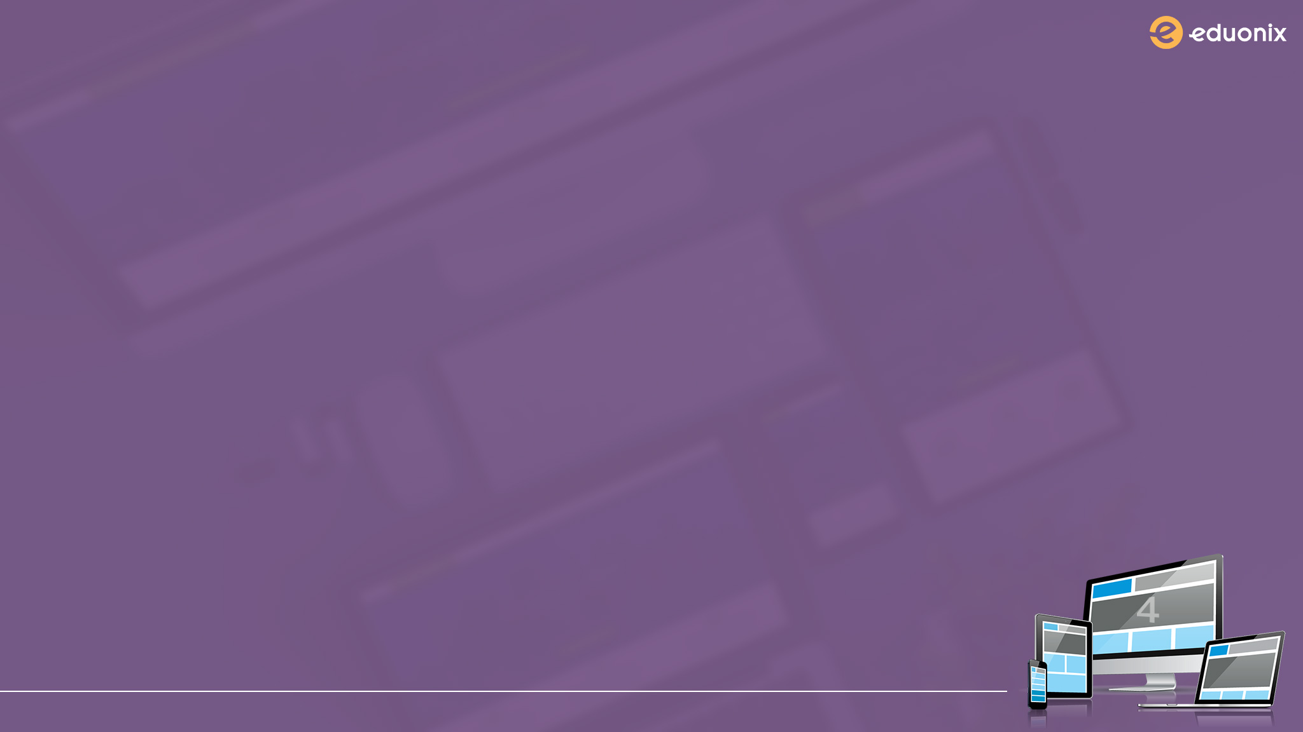
LAB - compiling more JavaScript
Go here https://pushjs.org
Install push.js with npm
Add push.js JavaScript file to gulp.js
Compile JavaScript in one file by running gulp scripts in your terminal
Test push.js framework by firing up browser notification
BONUS: Find out what “--save” does?

